Slide 1

PRESENTATION
ELECTRONIC AND TELECOMMUNICATIONS ENGINEERING
GENERATING ARTISTIC IMAGES USING NEURAL STYLE TRANSFER WITH PRE-TRAINED CONVOLUTIONAL NEURAL NETWORKS
BY NGUYEN DUC TRI & DR.TRAN THANH PHUONG

Slide 2




Generating Artistic Images Using Neural Style Transfer with Pre-Trained Convolutional Neural Networks
BY NGUYEN DUC TRI & DR.TRAN THANH PHUONG

Slide 3
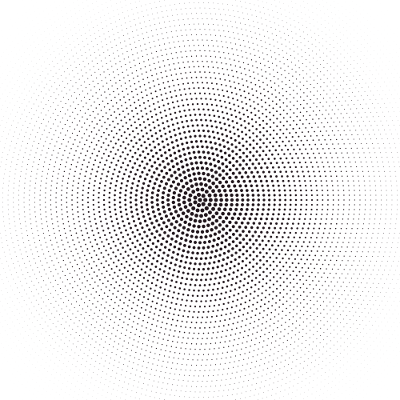



Contents
01
INTRODUCTION
02
CONTENT LOSS
03
STYLE LOSS-GRAM MATRIX
NEURAL STYLE
TRANSFER
04
05
CONCLUSION

Slide 4




01
Introduction

Slide 5
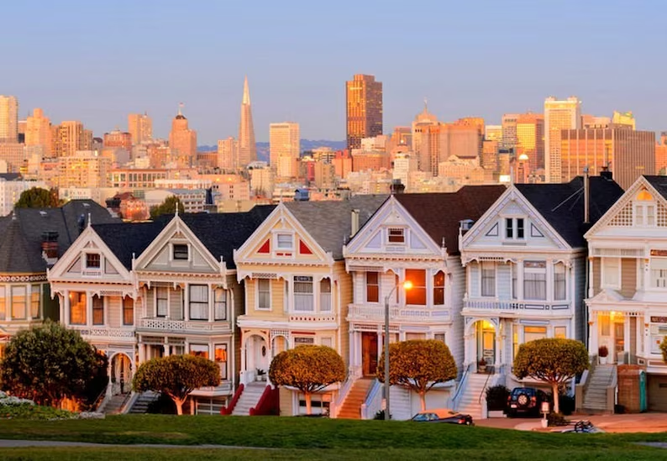
01
Introduction
Neural Style Transfer (NST) is a technique in computer vision that takes two images — a content image and a style image to blend them together so that the resulting image retains the characteristic elements of the content image, but appears to be “painted” in the style of the style image.

Slide 6
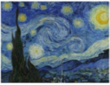
01
Introduction
Neural Style Transfer (NST) is a technique in computer vision that takes two images — a content image and a style image to blend them together so that the resulting image retains the characteristic elements of the content image, but appears to be “painted” in the style of the style image.

Slide 7
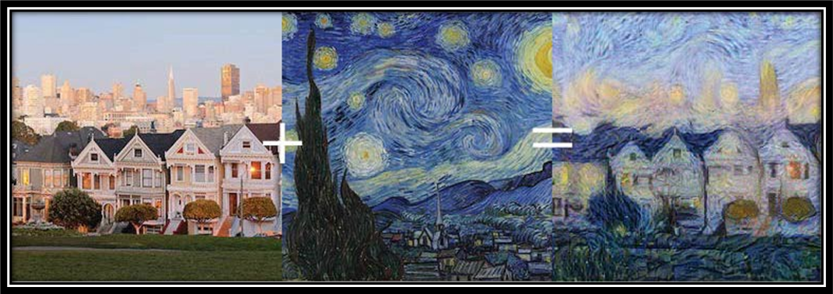
01
Introduction
Neural Style Transfer (NST) is a technique in computer vision that takes two images — a content image and a style image to blend them together so that the resulting image retains the characteristic elements of the content image, but appears to be “painted” in the style of the style image.

Slide 8
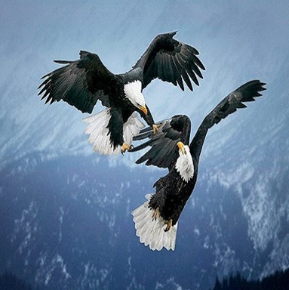
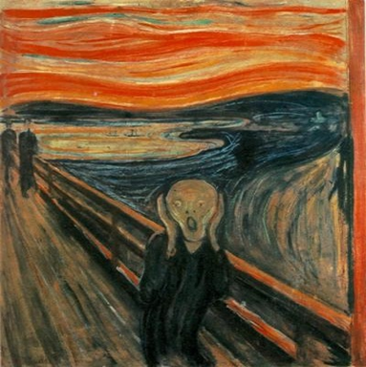
01
Introduction

Slide 9
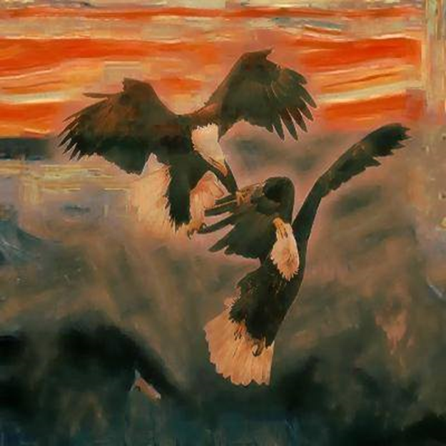
01
Introduction

Slide 10
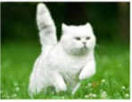

01
Introduction

Slide 11
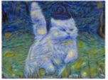
01
Introduction

Slide 12
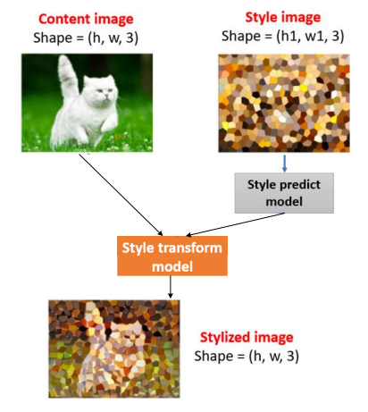
01
Introduction

Slide 13
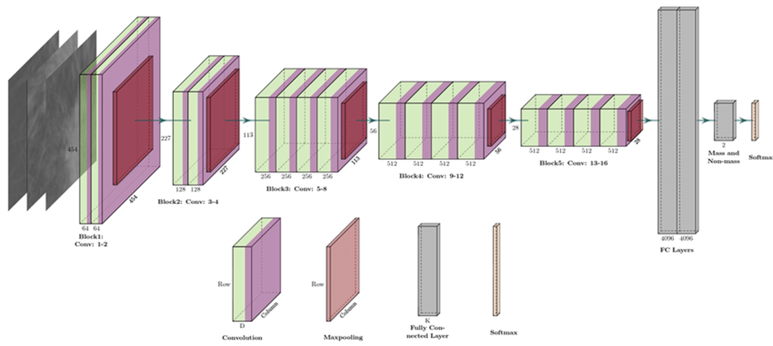
01
Introduction

Slide 14
Contents
01
INTRODUCTION
02
CONTENT LOSS
03
STYLE LOSS-GRAM MATRIX
NEURAL STYLE
TRANSFER
04
05
CONCLUSION

Slide 15
02
Content Loss

Slide 16
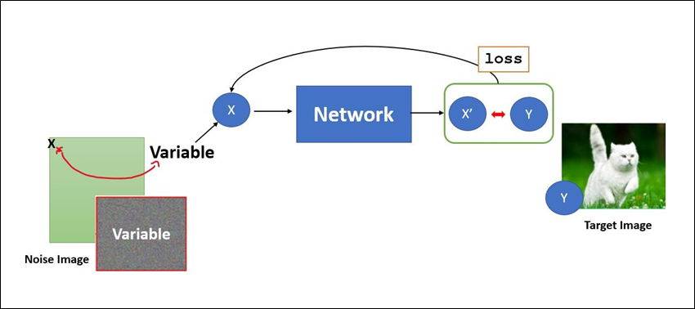
02
Content Loss
Mean Square Error:(𝑋′ − 𝑌)
2

Slide 17
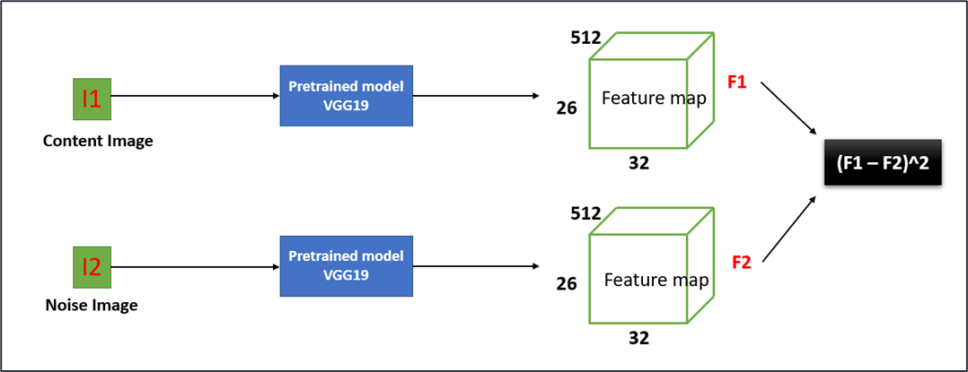
02
Content Loss

Slide 18
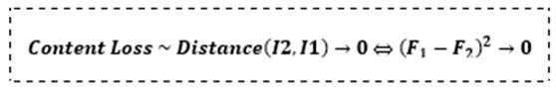
02
Content Loss

Slide 19
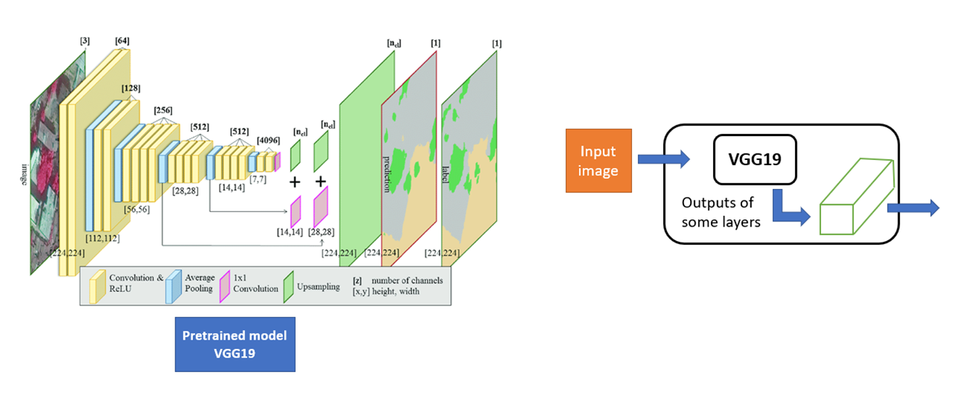
02
Content Loss

Slide 20

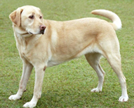
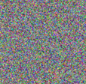

Content Loss
I1
I2
Fixed constant
Variable
Content Image
Noise Image

Slide 21
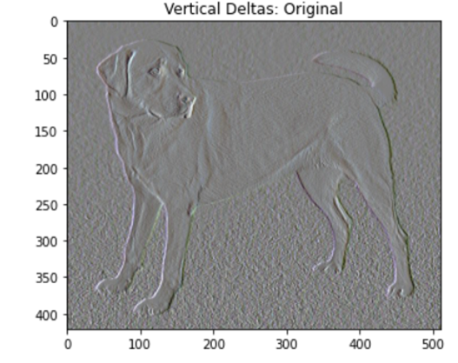
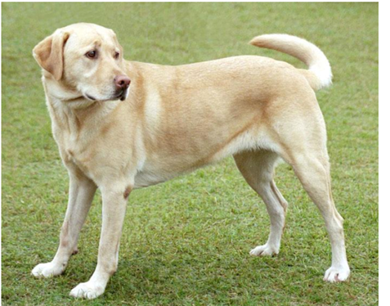
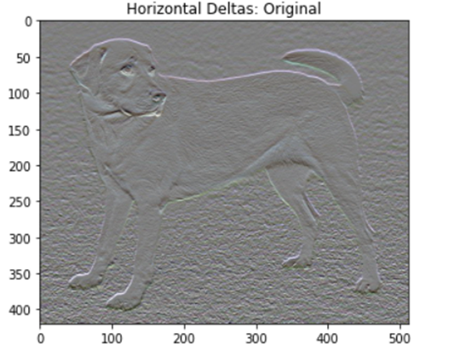
Content Loss

Slide 22
Contents
01
INTRODUCTION
02
CONTENT LOSS
03
STYLE LOSS-GRAM MATRIX
NEURAL STYLE
TRANSFER
04
05
CONCLUSION

Slide 23
Style loss -Gram matrix
03

Slide 24
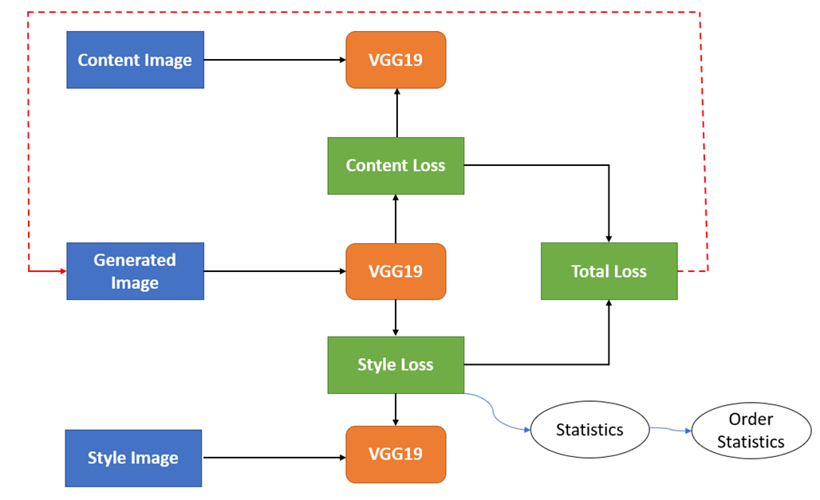
03
Style Loss - Gram Matrix

Slide 25
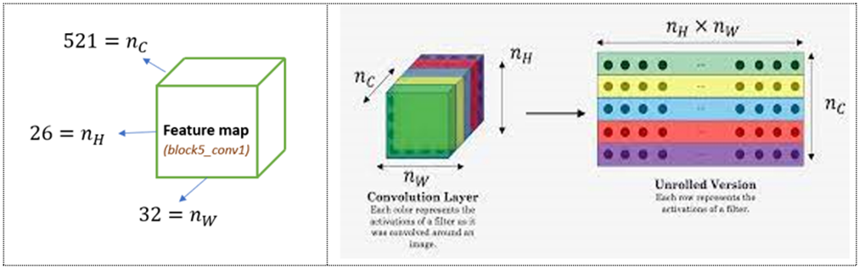
03
Style Loss - Gram Matrix

Slide 26
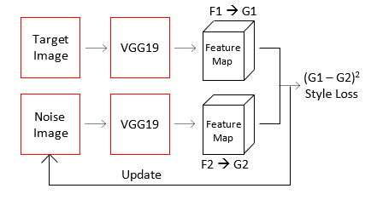
03
Style Loss - Gram Matrix

Slide 27
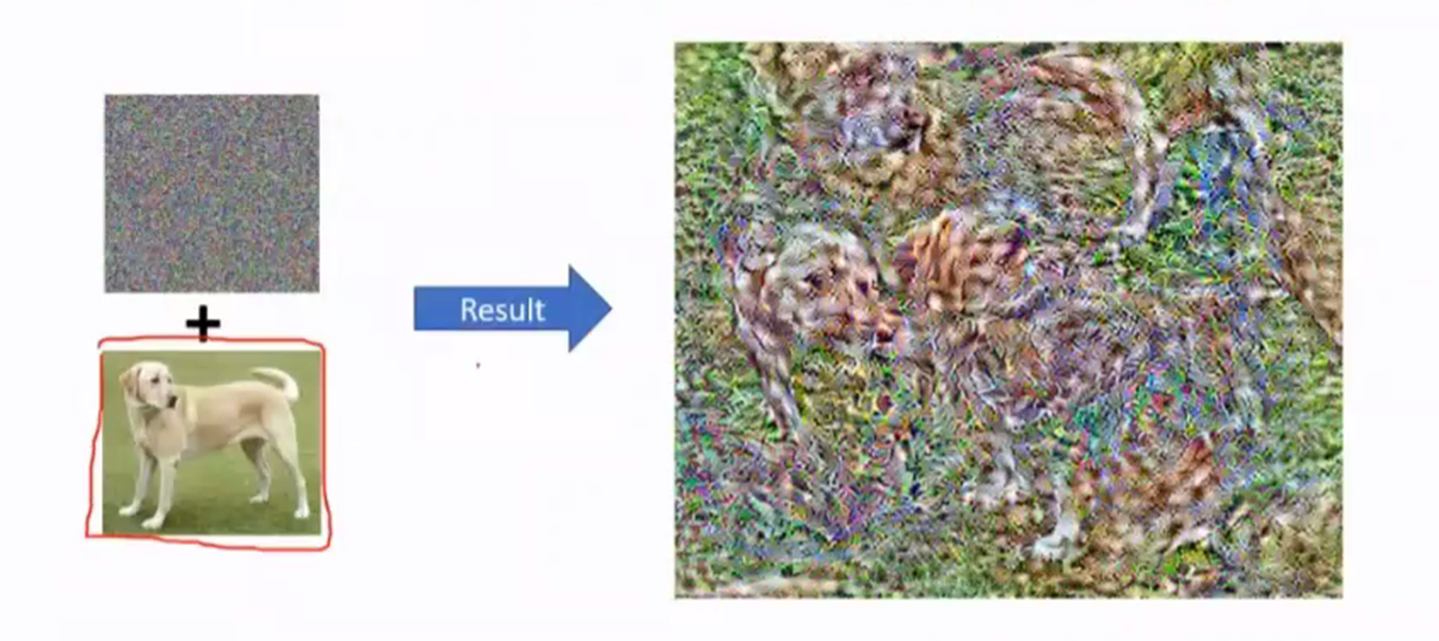


03
Style Loss - Gram Matrix
dog tail
dog head

Slide 28
Contents
01
INTRODUCTION
02
CONTENT LOSS
03
STYLE LOSS-GRAM MATRIX
NEURAL STYLE
TRANSFER
04
05
CONCLUSION

Slide 29
Neural style transfer
04

Slide 30
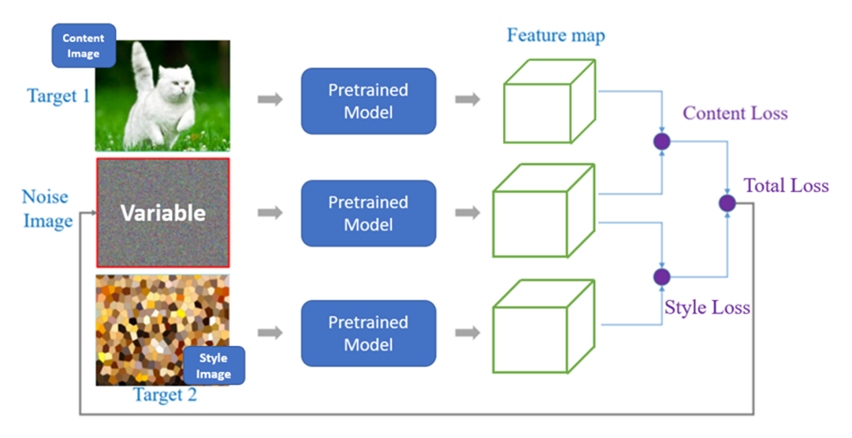
04
Neural Style Transfer

Slide 31
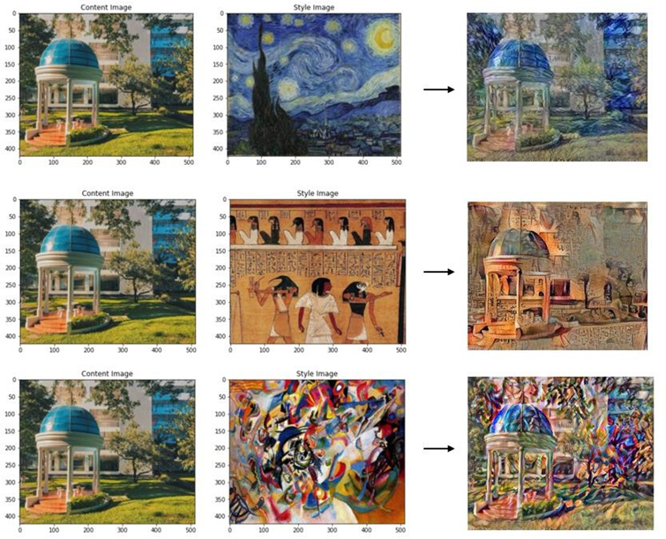
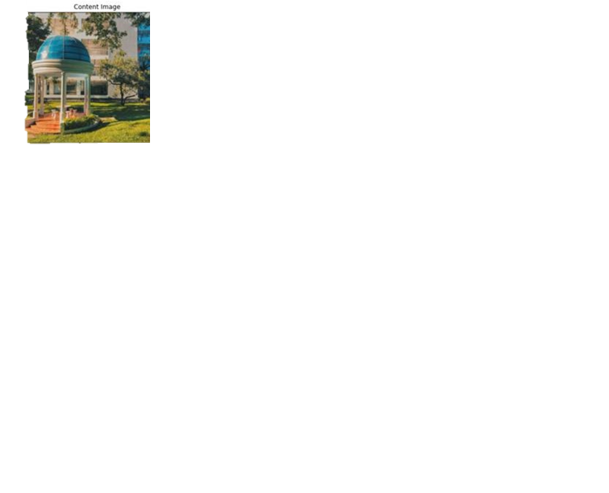
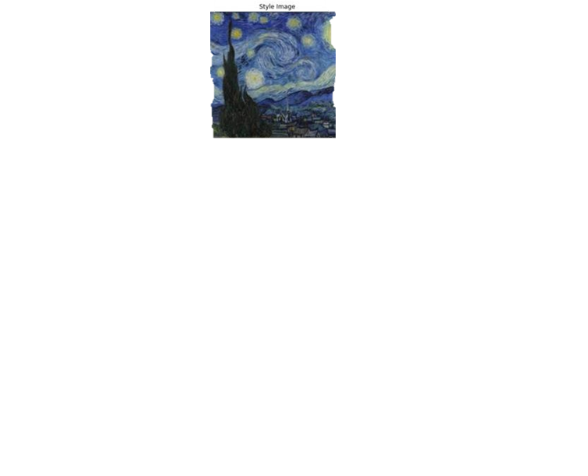
Neural Style Transfer
Content
Image
Stylized
Image
Style
Image

Slide 32
Neural Style Transfer
Content
Image
Stylized
Image
Style
Image

Slide 33
Neural Style Transfer
Content
Image
Stylized
Image
Style
Image

Slide 34
Contents
01
INTRODUCTION
02
CONTENT LOSS
03
STYLE LOSS-GRAM MATRIX
NEURAL STYLE
TRANSFER
04
05
CONCLUSION

Slide 35
05
Conclusion

Slide 36
05
Conclusion

Slide 37
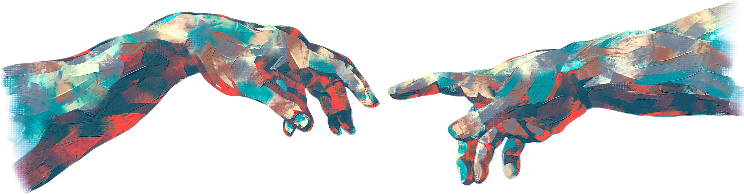
ANY QUESTION ?

Slide 38

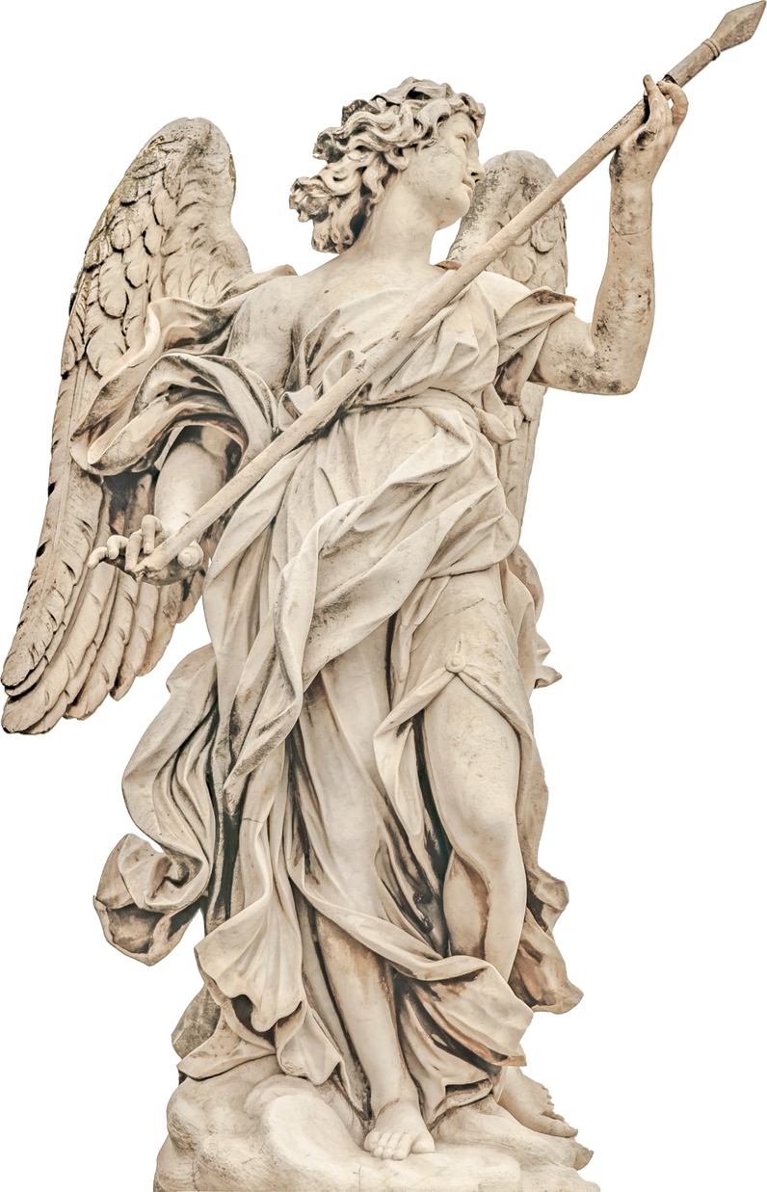
thank
you

